Slide 1
Requirement Gathering
First we analysed the situation of our locality by seeing our locality’s whatsapp groups and news.
Then we asked people what they were looking for and what help they can offer or wish to get. For eg. Plasma Donors, Lunch services, oxygen concentrators, oxymeters etc.
Then we made the website and spread awareness about our website so people will be able to register there and help people who were looking for it. For eg. People looking for plasma donors were helped by getting the information of people who just recovered from covid in past few days and wanted to give plasma etc.

Slide 2
Module and explanation
We are making a website for resource sharing in a locality through which residents would be able to help each other instead of wasting hours in lines or searching internet for hours.
Our website helps people to connect to people who want to help but are not being able to because they are not aware that who needs help.
Through our website you can make your profile and then you will be redirected to a page where you can enter what helps you offer or you seek and then you’ll be able to find the donors or helpers who are interested in helping for same.

Slide 3
Complete solution of Problems
This website allows you to find people who are willing to help free of cost so you don’t have to stand in lines or take help of any black marketer.
Forwards on whatsapp, facebook and other social media are not verified but here you probably know most of the people because they are in your neighbourhood and can seek help from them.
Our website is very user friendly so you wont have to spend a long time in creating profile or looking for help you need.
It also consists of a emergency board which is for people who need help immediately for their loved ones.
We also share verified news and facts so you can understand the difference between rumours and the reality about the covid-19 virus.

Slide 4
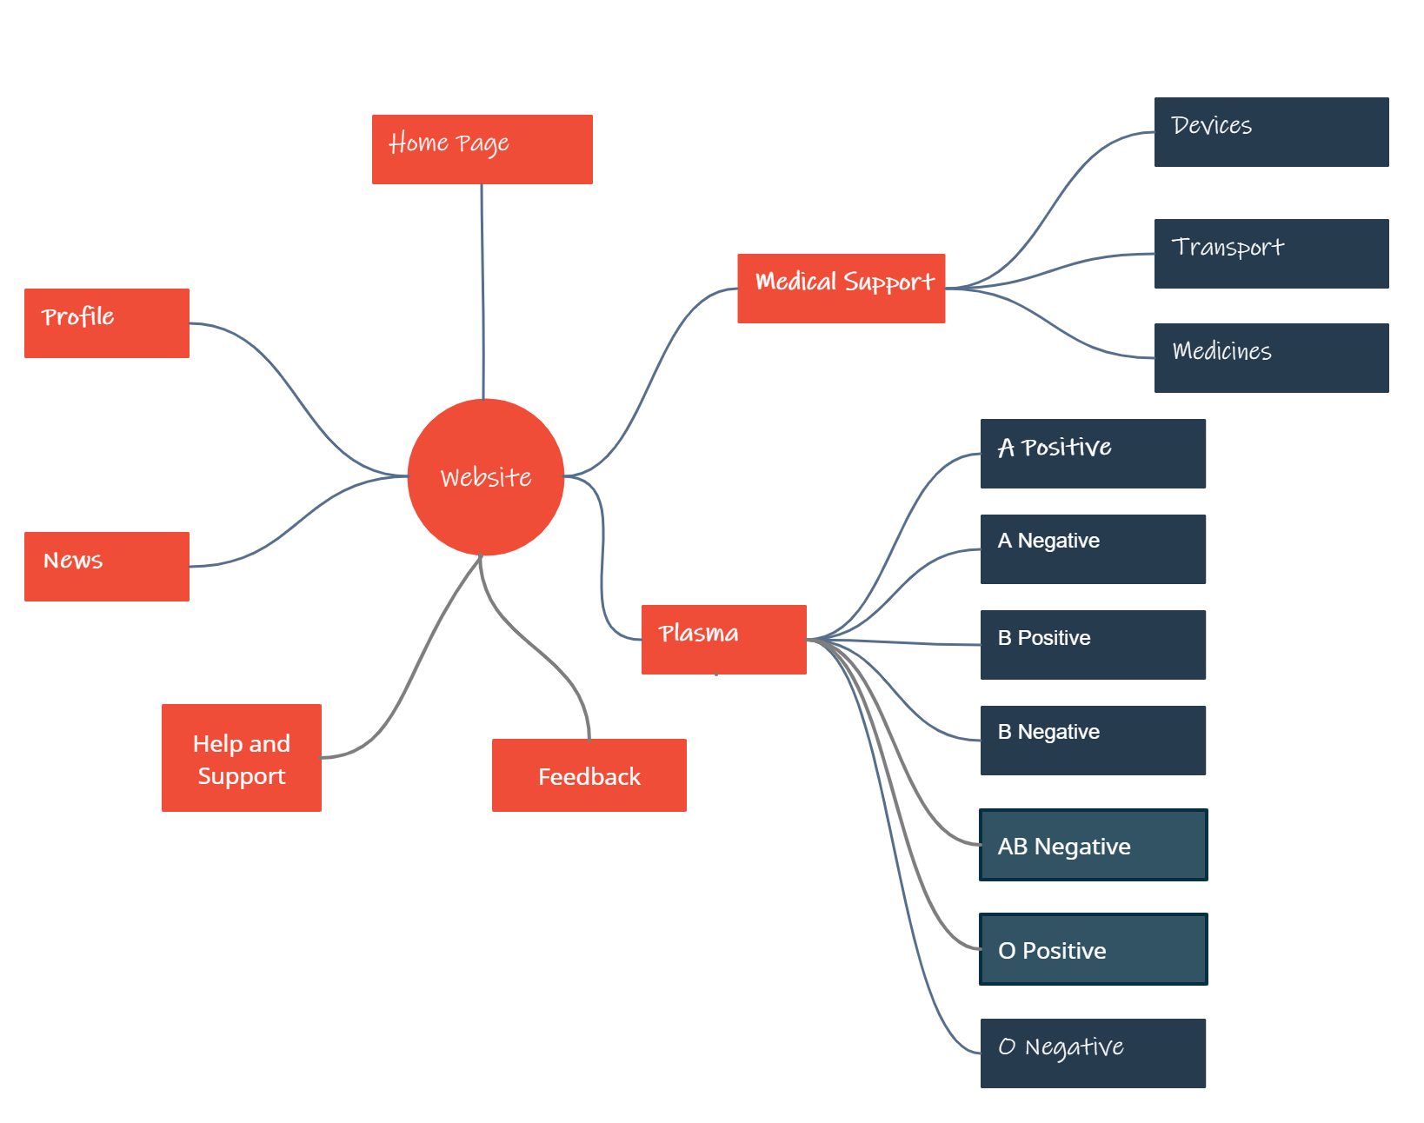
ERD

Slide 5

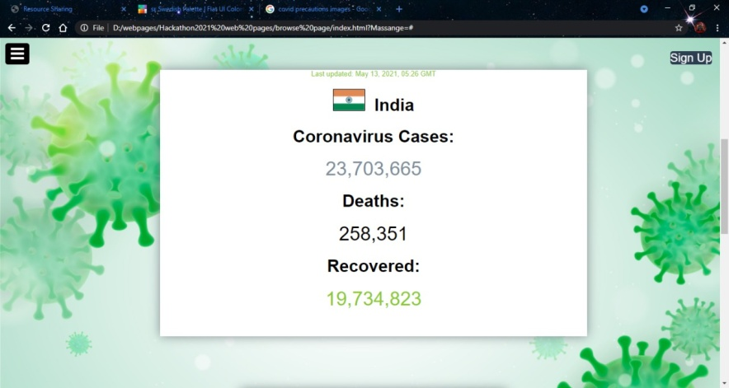
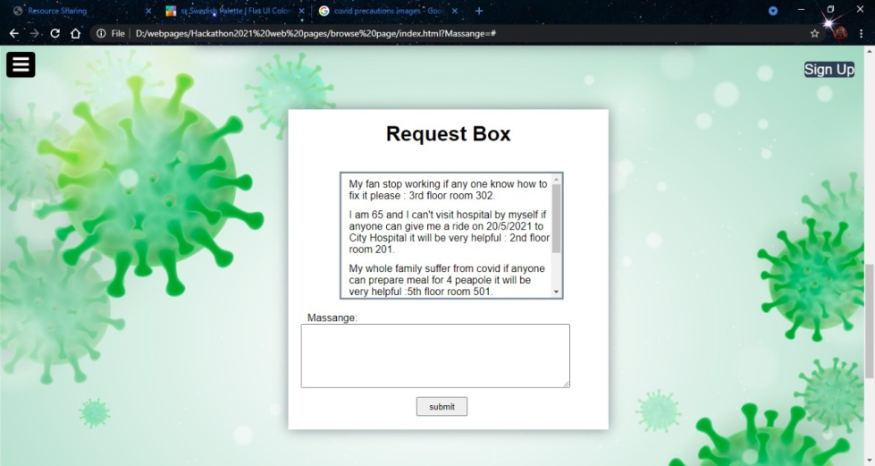
Website Overview

Slide 6
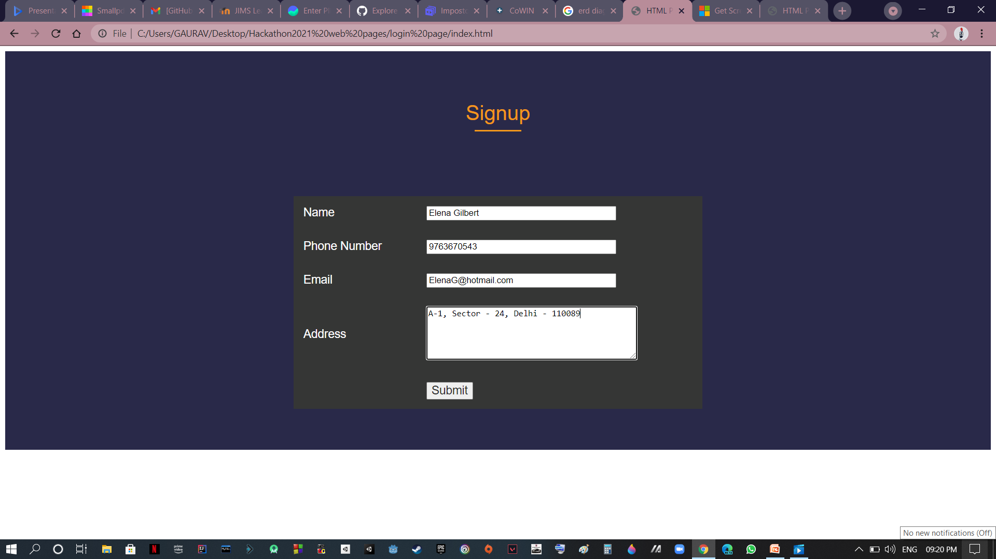
Profile Sign in Page

Slide 7
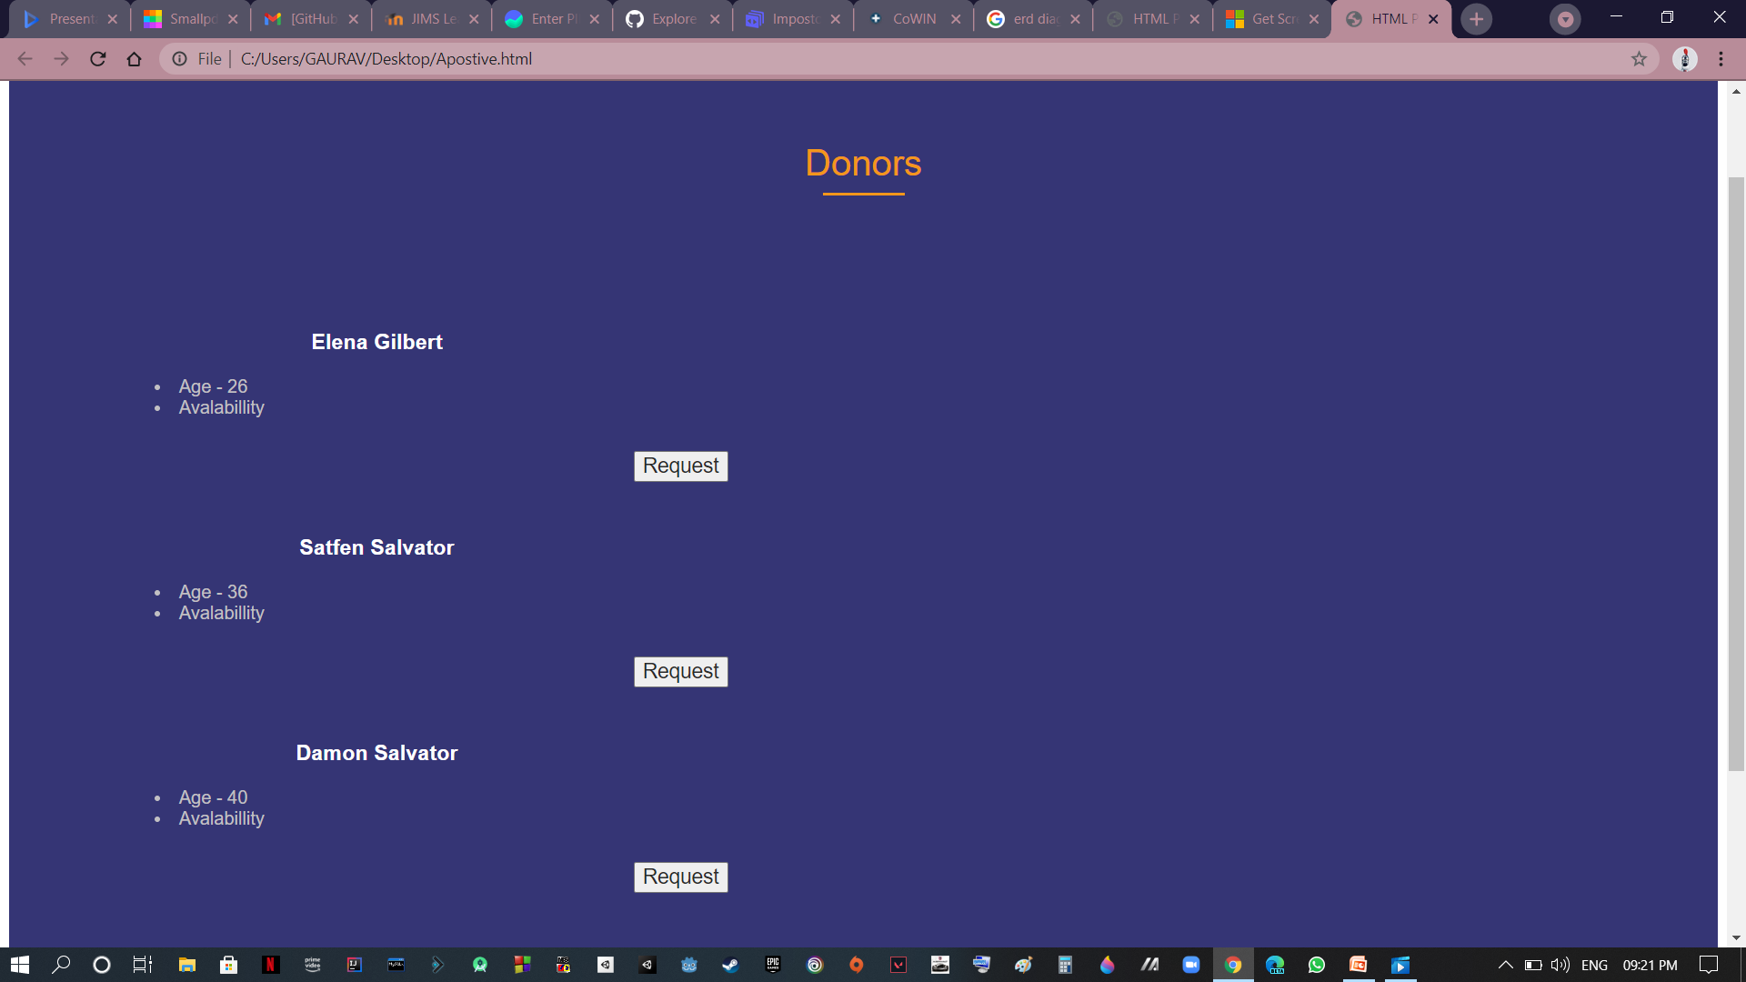
Output in our Database

Slide 8
Team Name – Alpha Bandits
Members’ Name
Gaurav Mittal
Akshar Bisht
Subhadip Jana
Bhumik Virmani
Shudhanshu Jha

